Slide 1


Azure Live Session

Slide 2
Agenda
Introduction to Azure , Free services and Pricing calculator
Subscription Types
EA Portal.
New User creation in Azure portal
Azure AD SSO login setup.
Key Vault and Benefits
Azure Storage and Types
SQL Database creation and Migration Assistant tool
Azure Redis Cache
SendGrid

Slide 3
Azure Introduction

Slide 4
Introduction to Azure
Microsoft Azure is Cloud Computing Platform.
An online portal that allows you to access and manage cloud services and resources provided by Microsoft. These services and resources include storing your data and transforming it, depending on your requirements.
It was launched on February 1, 2010, significantly later than its main competitor, AWS.
80 % of the Fortune 500 companies use Azure services.
Azure supports multiple programming languages, including Java, Node Js, and C#.
Azure has the more data centers comparing other clouds(AWS or Google cloud). Total Data centers - 58 Azure regions and 12 regions to be opened soon.

Slide 5






Introduction to Azure
2008
2010
2006
GCP
Azure
AWS

Slide 6
Cloud Service Providers
Amazon web service
IBM
Vmware
Google cloud platform
Rock space.

Slide 7
Market Share
GCP
Azure
AWS
Market Share
Market Share
Market Share
16.5%
28.1%
37.1%
Total Services
Total Services
Total Services
90 +
200 +
212 +

Slide 8
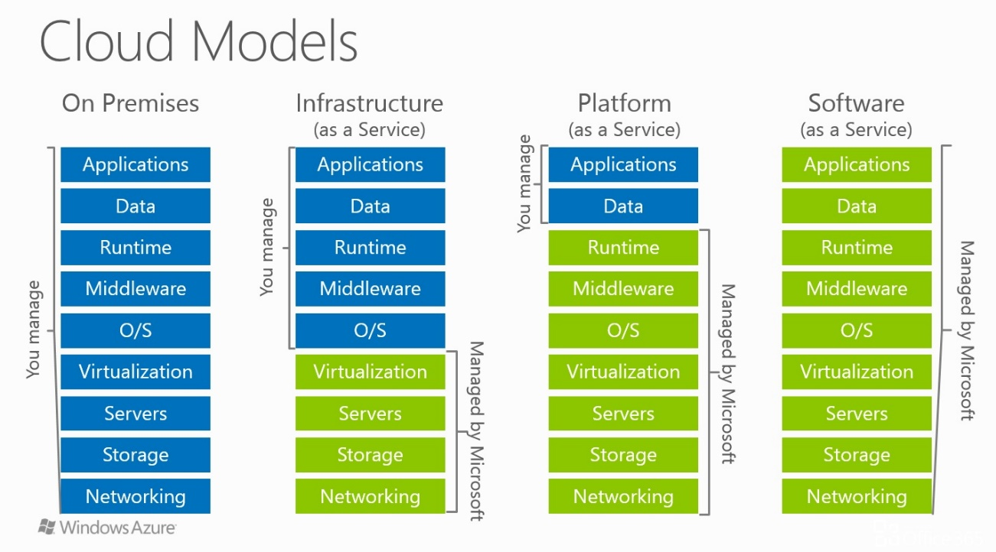
Cloud Delivery Models

Slide 9
Cloud Computing Deployment Models
Public cloud - As the name suggests, this type of cloud deployment model supports all users who want to make use of a computing resource, such as hardware (OS, CPU, memory, storage) or software (application server, database) on a subscription basis. Most common uses of public clouds are for application development and testing, non-mission-critical tasks such as file-sharing, and e-mail service.
Private cloud - True to its name, a private cloud is typically infrastructure used by a single organization. Such infrastructure may be managed by the organization itself to support various user groups, or it could be managed by a service provider that takes care of it either on-site or off-site. Private clouds are more expensive than public clouds due to the capital expenditure involved in acquiring and maintaining them. However, private clouds are better able to address the security and privacy concerns of organizations today.

Slide 10
Cloud Computing Deployment Models
Hybrid cloud - In a hybrid cloud, an organization makes use of interconnected private and public cloud infrastructure. Many organizations make use of this model when they need to scale up their IT infrastructure rapidly, such as when leveraging public clouds to supplement the capacity available within a private cloud. For example, if an online retailer needs more computing resources to run its Web applications during the holiday season it may attain those resources via public clouds.
Community cloud - This deployment model supports multiple organizations sharing computing resources that are part of a community; examples include universities cooperating in certain areas of research, or police departments within a county or state sharing computing resources. Access to a community cloud environment is typically restricted to the members of the community.

Slide 11
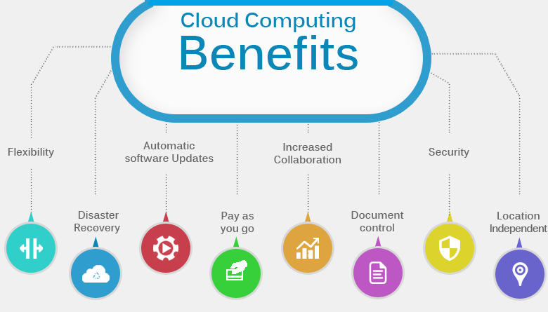

Slide 12
Azure Subscription Limitations
Azure Resource | Soft / Default Limit | Hard / Max Limit
CPU Cores per Subscription | 20 | Contact support
Co-Administrators per Subscription | Unlimited | Unlimited
Resource Groups per Subscription | 800 | 800
Storage Accounts per Subscription | 200 | 250
Cloud Services per Subscription | 20 | 200
Local Networks per Subscription | 10 | 500
SQL Database Servers per Subscription | 6 | 150
DNS Servers per Subscription | 9 | 100
Reserved IPs per Subscription | 20 | 100
Alert Rules per Subscription | 250 | 250

Slide 13
Azure Services and Free Services

Slide 14
Azure Pricing Calculator

Slide 15
Azure Subscription Types

Slide 16
Azure Subscription Types
01
FREE TRAIL
Azure offers one-month free trial for any new customer and provide credits of ₹13,300 Azure at no charge. The choice is now yours on how you use your Azure credits. Use them on any Azure service based on your needs including, Virtual Machines, Websites, Cloud Services, Mobile Services, Storage, SQL Database, Content Delivery Network, HDInsight, Media Services, and etc.,
02
PAY-AS-YOU-GO
This offer is billed at the standard Pay-As-You-Go rates, except as otherwise specified here in. Purchase Azure services directly from Microsoft with pay-as-you-go-pricing. Combine with Azure Reserved Virtual Machine Instances to save more. Pay for only what you use each month, with no upfront commitments. Cancel anytime.

Slide 17
Azure Subscription Types
03
MSDN
MSDN subscription offers you Microsoft products + Azure cloud. The most comprehensive set of resources for you to create, deploy and manage great applications on your preferred platforms and devices, including Android, iOS, Linux, macOS, Windows, web and the cloud.
04
ENTERPRISE
Azure Enterprise Agreement (EA) subscriptions were created in the EA Portal and management of services was completed in the Azure portal. Our goal is to converge on the Azure portal as the primary avenue for users to manage their Azure services and subscriptions

Slide 18
EA Portal

Slide 19
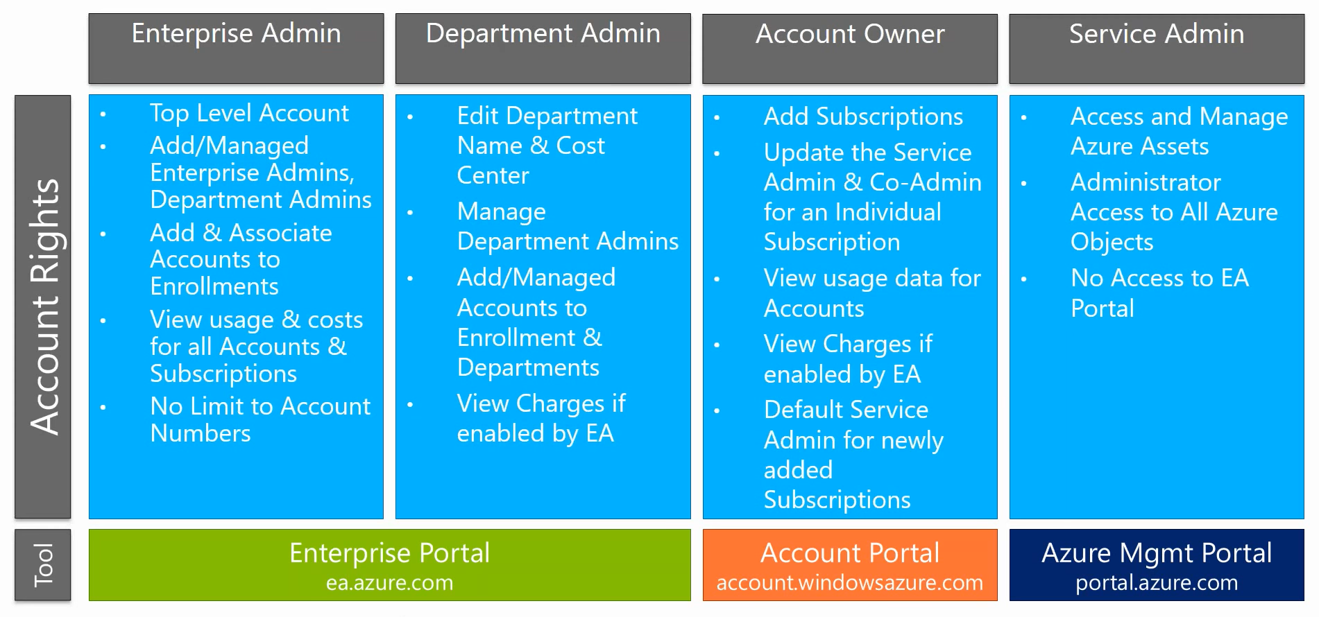
Azure Enterprise Rules

Slide 20
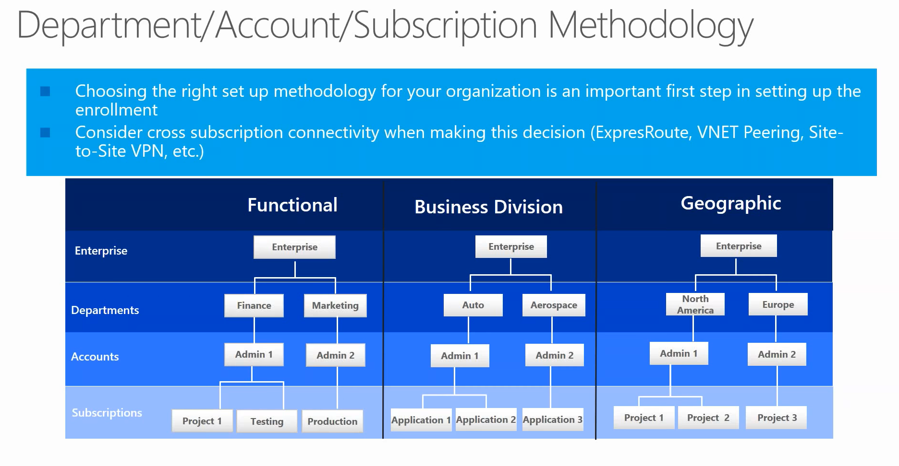
Azure Department/Account/Subscription Methodology

Slide 21
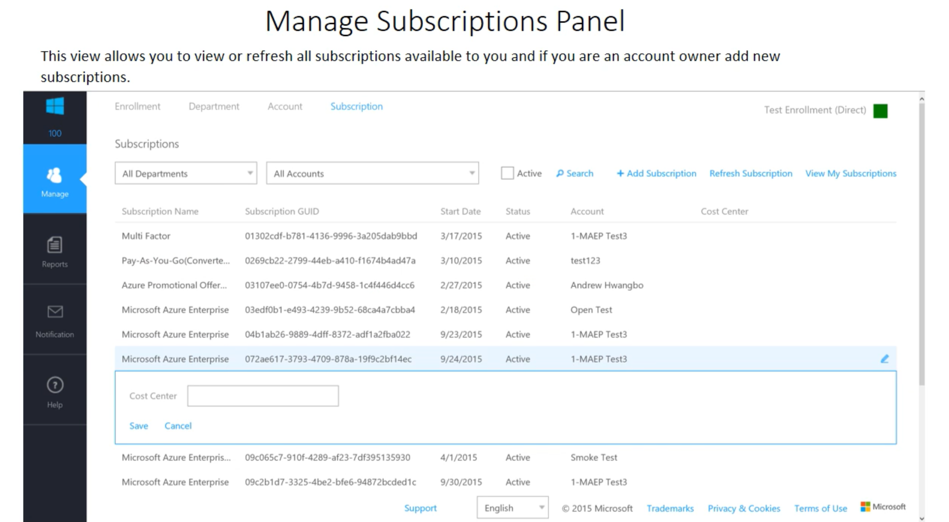
Manage Azure Subscription Panel

Slide 22
New User Creation in Azure portal

Slide 23
Azure AD SSO Login Setup

Slide 24
Key Vault and Benefits

Slide 25
Key Vault and Benefits
Azure Key Vault is a cloud service that provides a secure store for secrets. One can securely store passwords, keys and connection strings. Azure Key Vault can be created and managed using the Azure portal.
Advantages of Azure Key Vault :
Secrets Management – in a secure manner, one can store and control access to tokens, passwords, certificates, API keys, and other secrets.
Key Management – As a key management solution, Azure Key Vault simplifies the process of creating and managing encryption keys.
Certificate Management – It serves as a service to provision, manages, and deploy public and private Secure Sockets Layer/Transport Layer Security (SSL/TLS) certificates. These can be used with Azure and other internal connected resources.
Hardware Security Modules – Secrets and keys can be protected by software, or FIPS 140-2 Level 2 validated HSMs.

Slide 26
Azure Storage and Types

Slide 27
About Storage
Azure Storage is a Microsoft-managed cloud storage service, that provides highly available, durable, scalable and redundant storage.
Azure Storage is: Durable and highly available , Secure, Scalable, Managed and Accessible.
The very first thing you need to use storage in azure is a storage account.
After creating an account, you can transfer data to or from services in your storage account.
Azure offers 2 types of disk storage:
Managed :- Managed disk has some advantages over unmanaged disks in the sense that disks will be created and managed for you. This is a IaaS offering.
Unmanage:-With unmanaged disks, you must manage it yourself. Basically, this means that your virtual hard disks are stored in a storage account as page blobs.

Slide 28
Types of Azure Storage
Azure storage is easily scalable, extremely flexible and relatively low in cost depending on the options you choose.
There are 4 types of storage in Azure, namely:
File
Blob
Queue
Table

Slide 29
Types of Azure Storage
Blobs Storage:
The word blob is an acronym which stands for binary large object. Azure Blob storage is a service that stores unstructured data in the cloud as objects/blobs. Blob storage can store any type of text or binary data, such as a document, media file, or application installer. Blob storage is also referred to as object storage.
Blob Storage can be divided into two access tiers, a Hot access tier for data which is accessed frequently and a Cold access tier for data which is not accessed very often.
Types of Blob Storage
Block blobs are made of blocks. Each block has a unique block ID. Blocks can be different sizes, potentially up to a maximum of 4.75TB.
Append blobs are used to append data. Basically, this means that each time you make changes to the blob, the data will be appended at the end of the blob. Data cannot be changed or deleted, only appended.
Page blobs are compilation of pages. They allow random read and write operations.
While creating a blob, if the type is not specified they are set to block type by default
.

Slide 30
Types of Azure Storage
Tables Storage:
The Azure Table storage service stores large amounts of structured data in key-value format .
The service is a NoSQL datastore which accepts authenticated calls from inside and outside the Azure cloud.
Azure tables are ideal for storing structured, non-relational data.
The three main parts of service are −
Tables :This is not a traditional table
Entities :An object which consists out of properties. Each entity has a partition key, a row key and a timestamp by default. An entity can store 252 properties.
Properties :The properties are the key-value pairs. Following are the properties supported,
GUID, Byte[], Int32 or int, Bool , Int64 or long, DateTime, String, Double.
.

Slide 31
Types of Azure Storage
File Share Storage :
A File Storage share is an SMB file share in Azure. All directories and files must be created in a parent share.
An account can contain an unlimited number of shares, and a share can store an unlimited number of files, up to the 5 TB total capacity of the file share

Slide 32
SQL Database Creation and Migration Assistant tool

Slide 33
Azure Redis Cache

Slide 34
Azure Redis Cache
Azure Redis Cache - is one of the cache service offerings from Microsoft Azure. Based on the popular open source Redis Cache, it allows the user to have the best of both worlds- rich features and eco system of Redis plus reliable hosting and monitoring from Microsoft.
Basic: This is mainly suitable for development/test purposes and non-critical workloads. It has a single node which is available in multiple sizes.
Standard: This provides replication through primary and secondary nodes. It supports multiple sizes and provides a SLA of 99.9% availability.

Slide 35
Azure Redis Cache
Premium: The Premium tier has all the standard features and, also, it provides better performance, bigger workloads, enhanced security, and disaster recovery. Backups and Snapshots and can be created and restored in case of failures. It also offers Redis Persistence, which persists data stored inside the cache. It also provides a Redis Cluster, which automatically shares data across multiple Redis nodes. Hence this allows creating workloads of bigger memory sizes and get better performance. It also offers support for Azure Virtual Networks, which gives the ability to isolate the cache by using subnets, access control policies, and other features.
RDB (Redis database) persistence: This option persists the data by taking a snapshot of the cache. The snapshot is taken based on the frequency configured. In the case of recovery, the most recent snapshot will be used.
AOF (Append only file) persistence: This option saves the data for every writes operation. In case of recovery, the cache is reconstruct using stored write operation.

Slide 36
Benefits of using Azure Redis Cache
High Performance due to the low latency and high throughput capacity of Redis engine. So, as the load on the application increases, it continues to remain available. And since the cache layer is separate, the data tier can be scaled independently.
Supports a variety of programming languages like C, C#, Java, PHP, VCL, Fancy, Io, Lua, Perl, Rust, Go, Scala, Matlab, Python.
Leverages Redis authentication and supports SSL for securing cache/client communication.
Makes Redis cache highly available by having primary and secondary replica cache. If the primary cache fails, the secondary replica is promoted to primary and a new replica is created and populated. This process is automatic and is managed by Microsoft Azure.
Monitoring the health and performance of the cache, configuring alerts when a certain threshold is crossed is easy and can be done through the Azure Management Portal.

Slide 37
Azure SendGrid

Slide 38
Azure SendGrid
SendGrid is a cloud-based email service that provides reliable transactional email delivery, scalability, and real-time analytics along with flexible APIs that make custom integration easy. Common SendGrid use cases include:
Automatically sending receipts or purchase confirmations to customers.
Administering distribution lists for sending customers monthly fliers and promotions.
Collecting real-time metrics for things like blocked email and customer engagement.
Forwarding customer inquiries.
Processing incoming emails.

